Slide 2
Multimedia Test

Slide 3
Instructions
This test has 40 questions.
Read the question on each PowerPoint slide carefully.
We will also read the questions to you.
Depending on the complexity of the question, we will give you 30 to 75 seconds for a question.
Each question is multiple-choice. Choose A, B, C or D.
Only one answer is correct.
Mark your choice on the Answer Sheet with a circle around the letter that you want to select. If you make a mistake, delete the selected letter and make a new choice.
We will read all questions to you again at the end of the test.

Slide 4
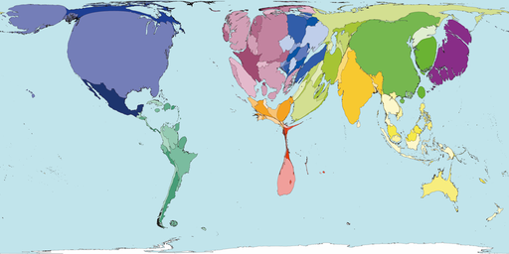
Q.1
What does this map represent?
A. Carbon emissions
B. Water reserves
C. Oil supplies
D. Wood supplies

Slide 5
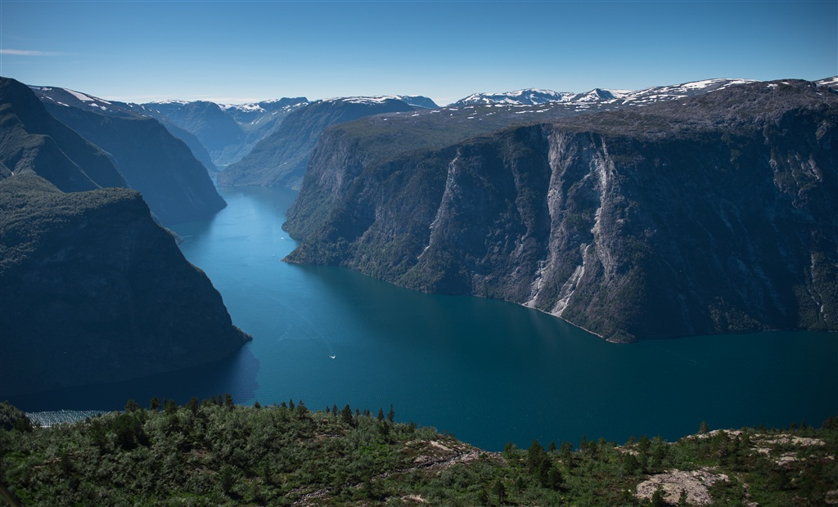
Q.2
In which country can you see this landscape?
A. Equatorial Guinea B. Iran
C. Norway D. Hungary

Slide 6
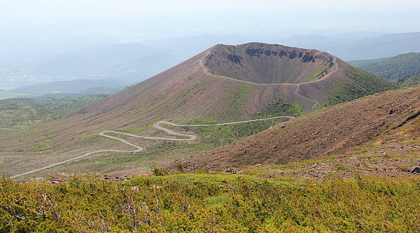
Q.3
Where can you find this type of volcano?
A. Italy B. Hawaii C. Iceland D. Japan

Slide 7
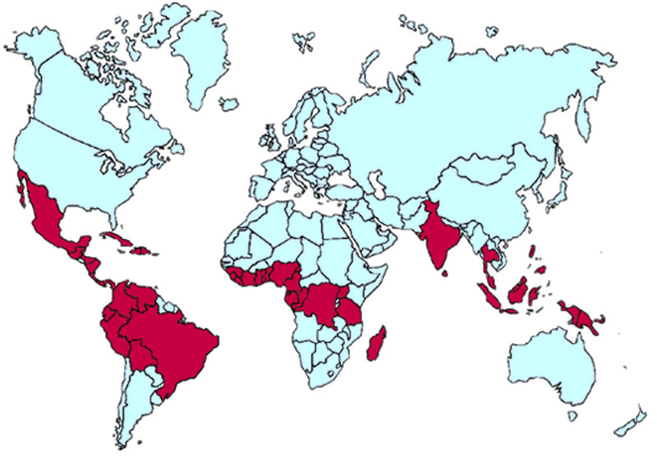
Q.4
What does this map represent?
A. Coffee production B. Cocoa production
C. Vanilla production D. Bananas production

Slide 8
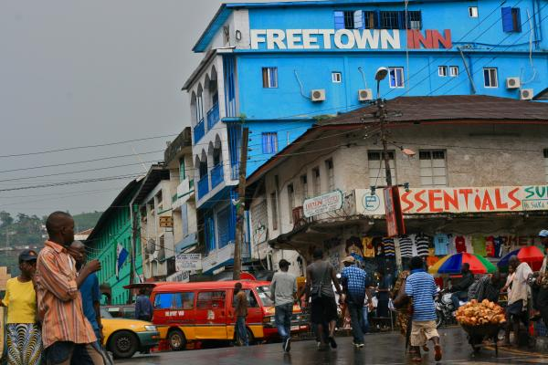
Q.5
Which country has the youngest population?
A. Nigeria B. Senegal
C. Sierra Leone D. Rwanda

Slide 9
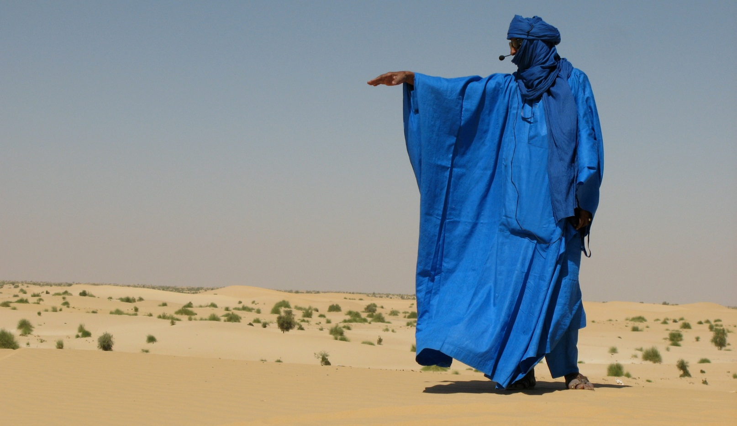
Q.6
Which ethnicity does this man represent?
A. BerberB. Tuareg C. Mendi D. Sara

Slide 10
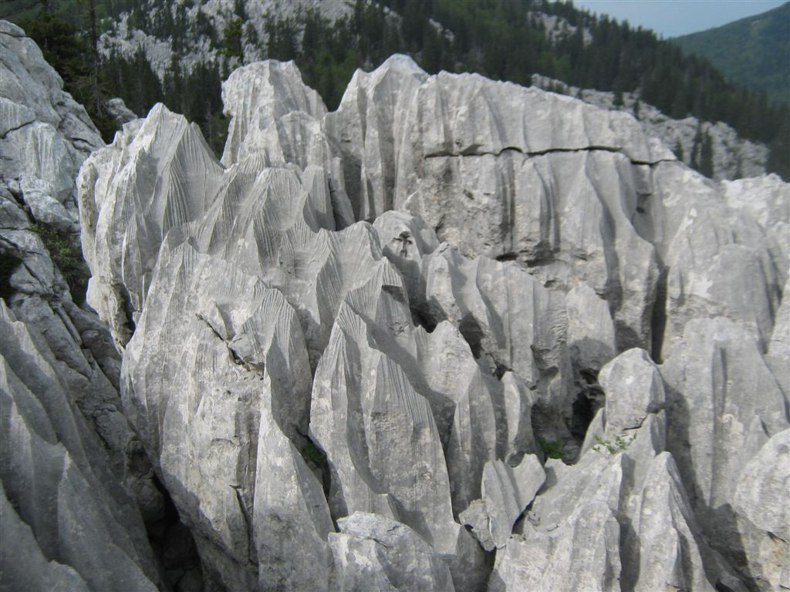
Q.7
Which type of erosion made this landform?
A. Wind erosion B. Karst erosion
C. Fluvial erosion D. Denudation

Slide 11
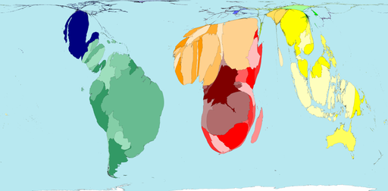
Q.8
What does this map represent?
A. Forest loss B. GDP per capita
C. Wheat production D.Total population

Slide 12
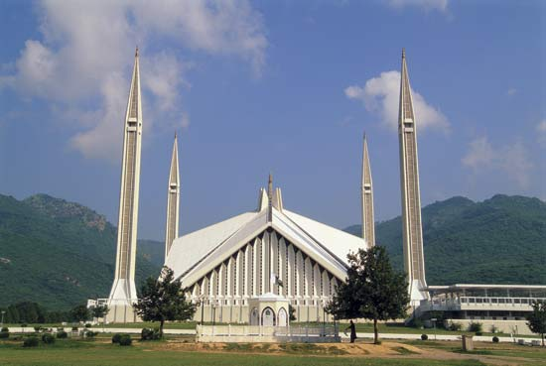
Q.9
Where the most refugees originated from, according to the UN?
A. Bangladesh
B. Pakistan
C. India
D. Myanmar

Slide 13
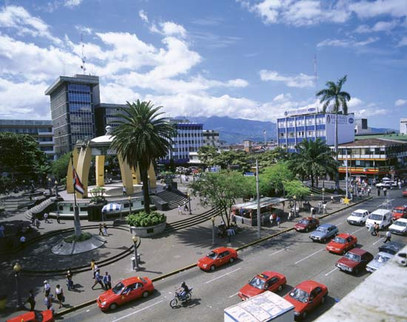
Q.10
Which of the following toponyms best defined by common traits of Catholicizm and Spanish language?
A. Dar es Salam
B. San Jose
C. Fauske
D. Saint Paul

Slide 14
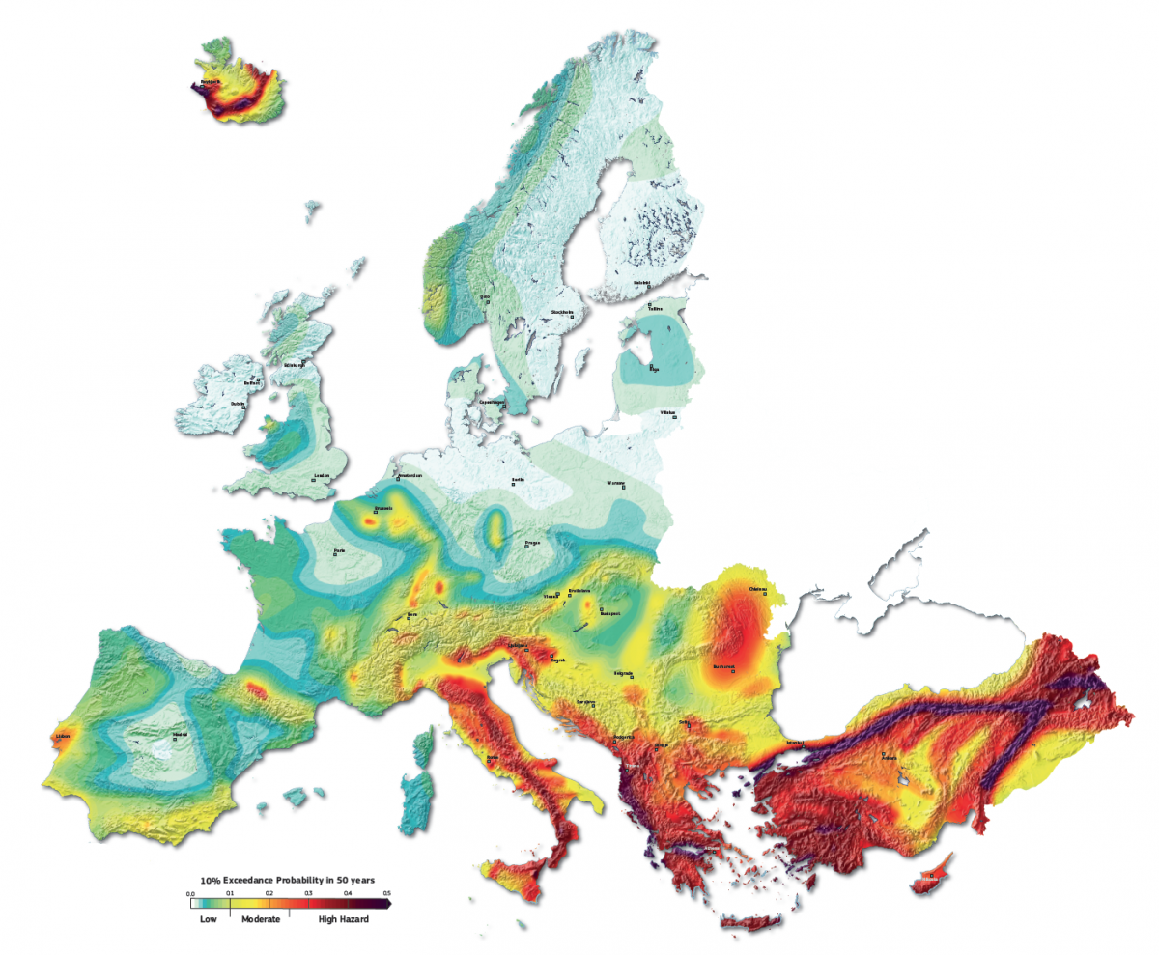
Q.11
What does this map represent?
A. Risks of floods B. Risks of earthquakes
C. Risks of droughts D. Risks of hail

Slide 15
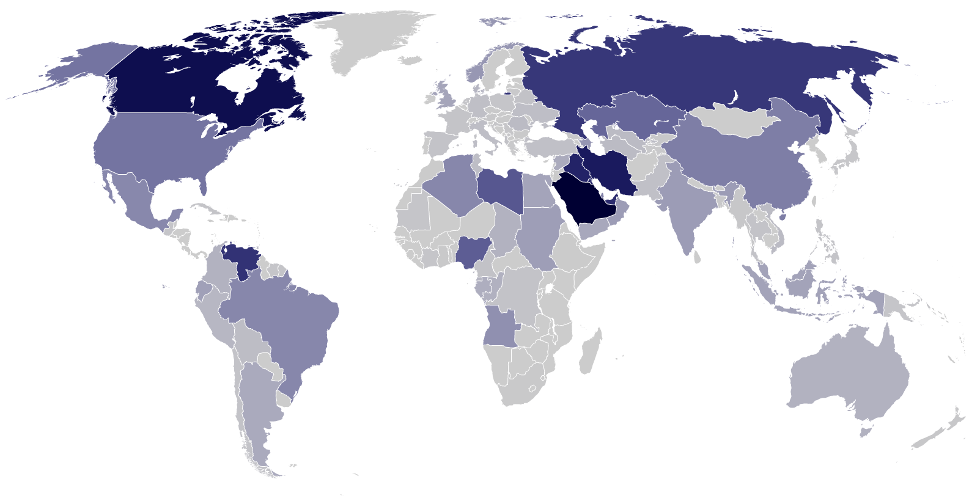
Q.12
What does this map represent?
A. Oil production B. Copper production
C. Coal production D. Lead production

Slide 16
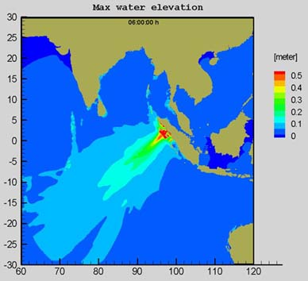
Q.13
Which country was most affected by tsunami in 2004 (with most victims)?
A. Maldives
B. Sri Lanka
C. Indonesia
D. Bangladesh

Slide 17
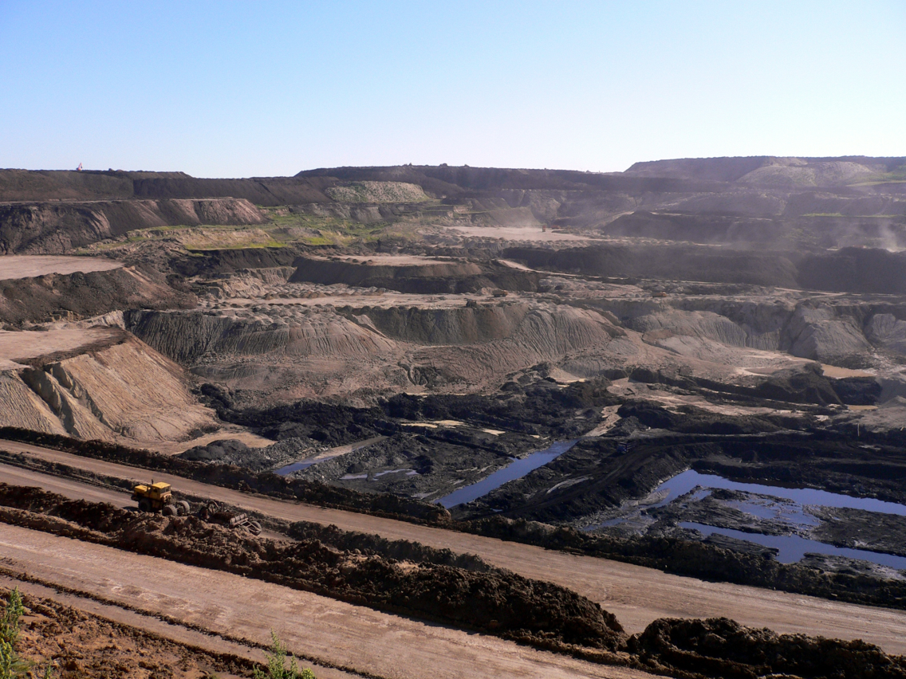
Q.14
Which mine is represented below?
A. Coal mine B. Copper mine
C. Lead mine D. Gold mine

Slide 18
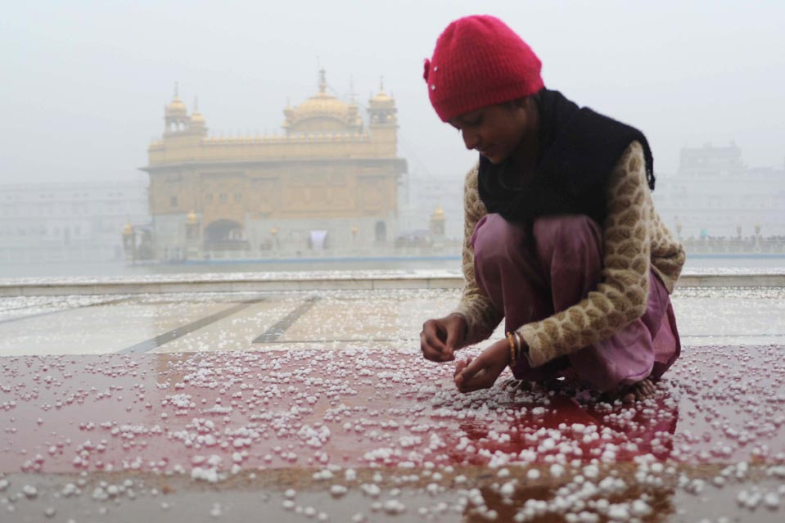
Q.15
The heaviest hail storm in history happened in:
A. India
B. Maldives
C. Serbia
D. Hungary

Slide 19
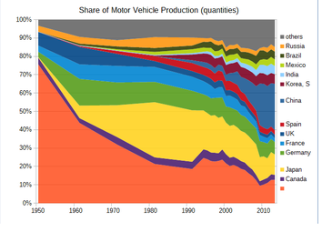
Q.16
The orange colour on this graphics shows car production in which country?
A. USA B. Italy C. Ireland D. Sweden

Slide 20
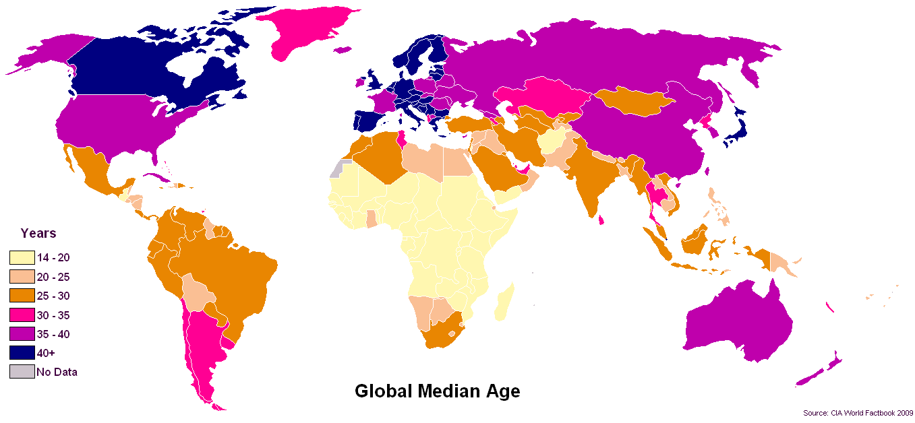
Q.17
According to the UN, which country has the oldest population?
A. Germany B. Serbia C. Japan D. South Korea

Slide 21
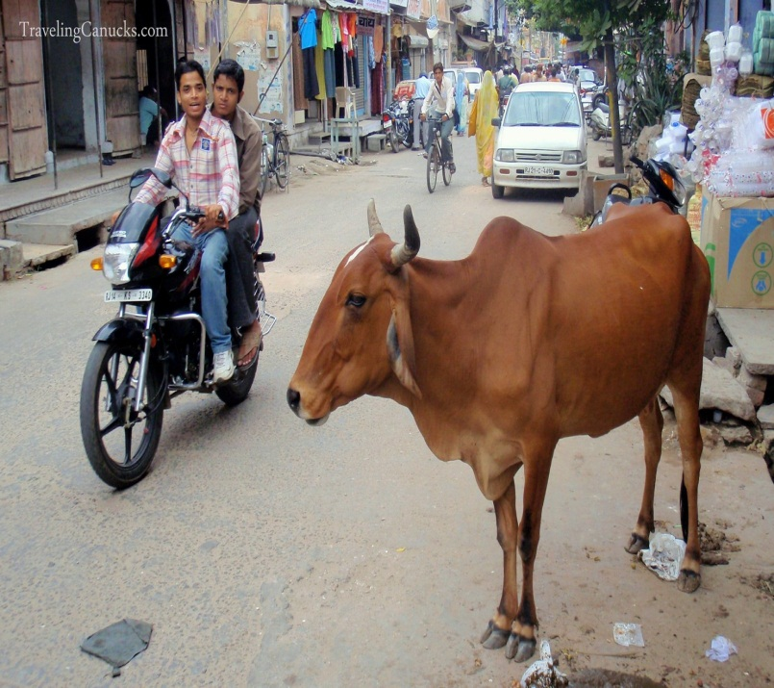
Q.18
The prohibition that forbids Hindus from slaughtering or consuming beef is an example of:
A. a Sharia law
B. a religious proscription
C. an ethnic conflict
D. an animistic tradition

Slide 22
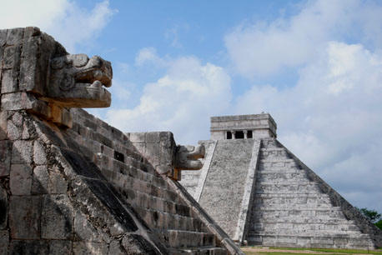
Q.19
Which of the following Amerindian languages is spoken on the Yucatan peninsula of Mexico?
A. Comanchan
B. Mayan
C. Cherokee
D. Lakota

Slide 23
Q.20
As many as 80 percent of all Muslims belong to the following denomination of Islam:
A. Dravidian B. Shia C. Sunni D. Meccan

Slide 24
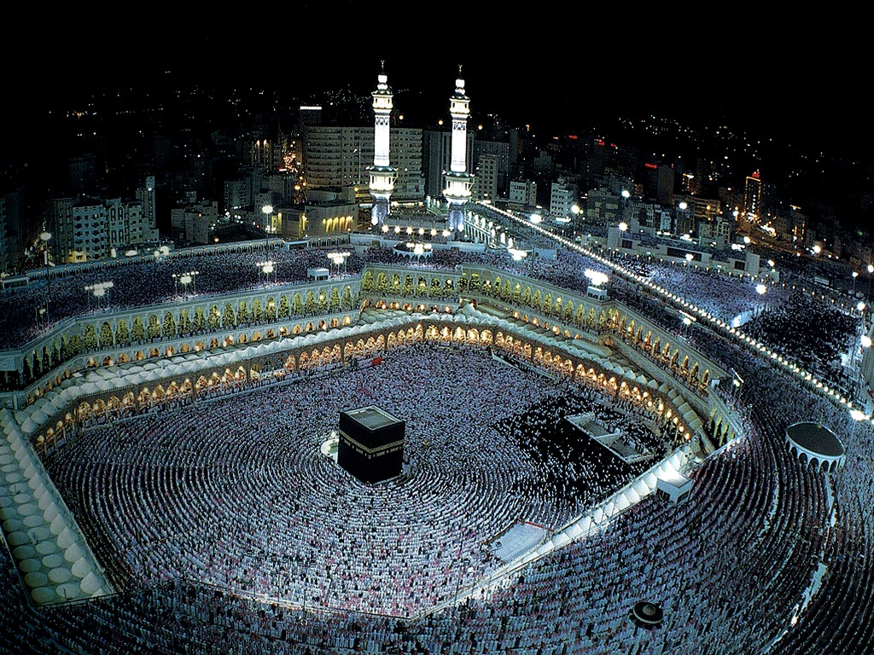
This picture represents:
Q.21
A. Medina
B. Mecca
C. Riyadh
D. Jerusalem

Slide 25
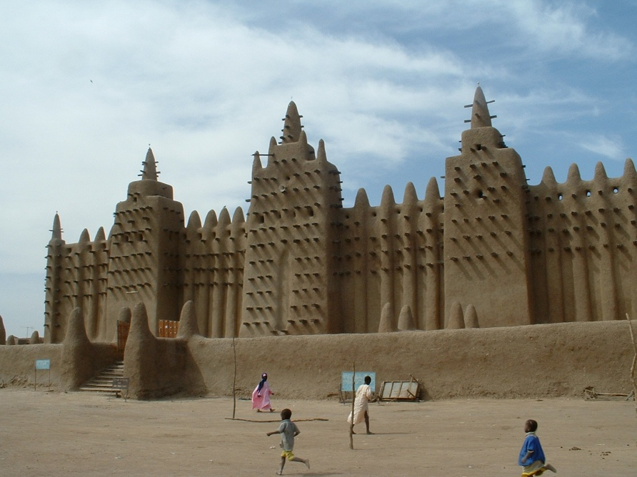
Where was the picture taken?
Q.22
A. Mali B. Algiers C. Niger D. Senegal

Slide 26
In global cities, frequent displacement of minority populations with low incomes is often caused by the process of:
Q.23
A. Social reproduction B. Urban blight
C. Gentrification D. Rent control

Slide 27
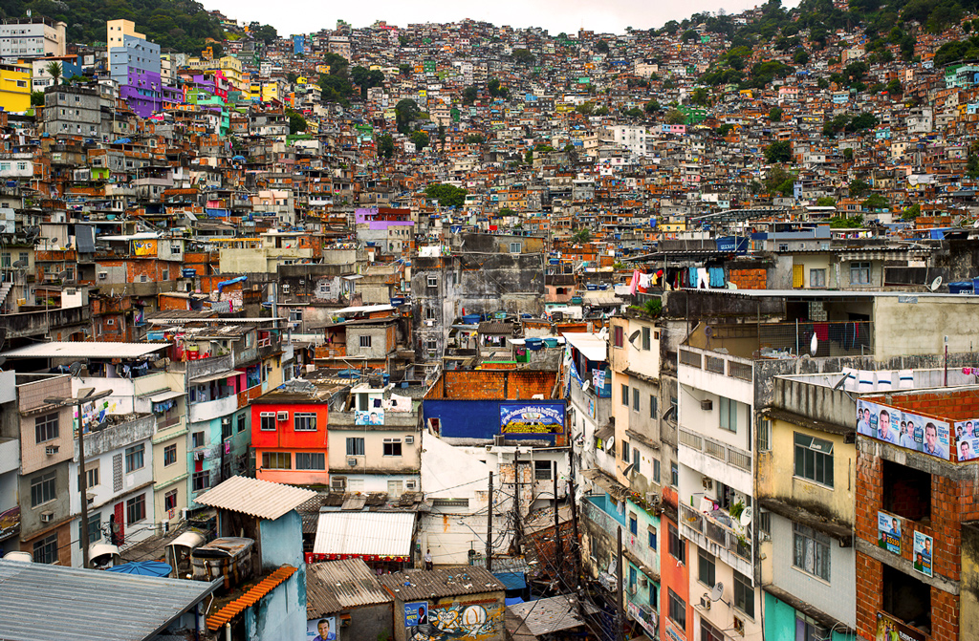
Find the wrong term:
Q.24
A. Bidonvilles B. Barrios
C. Favelas D. Maquiladoras

Slide 28
To which of these cities does the climate graph correspond?
Q.25
A. San Diego B. Vancouver
C. Marseille D. Madrid

Slide 29
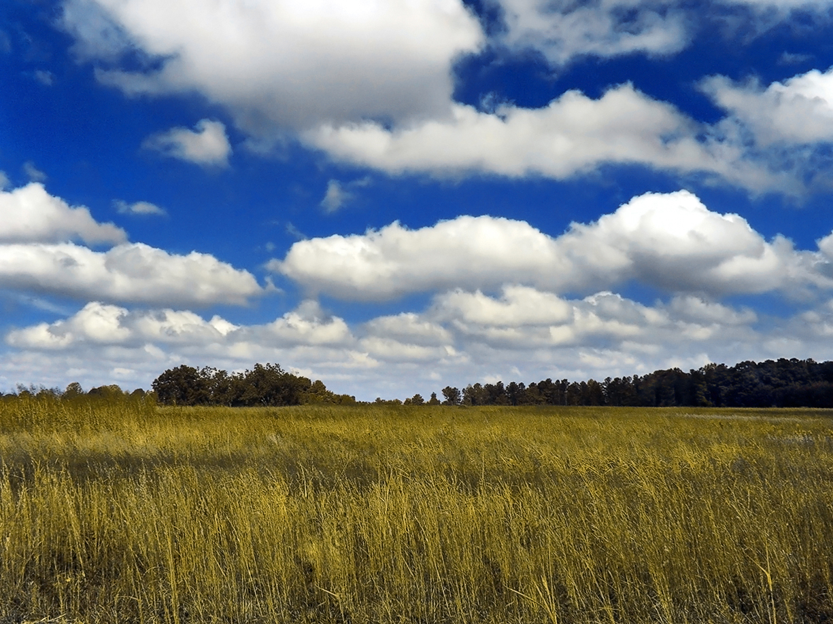
Name the cloud type on this picture:
Q.26
A. Cumulus
B. Cirrus
C. Stratus
D. Stratocumulus

Slide 30
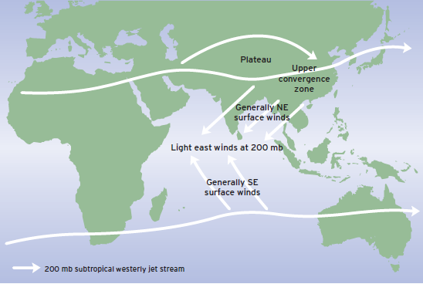
This schematic illustration of the major upper-troposphere features represents:
Q.27
A. Monsoon in the winter C. Typhoon
B. Monsoon in the summer D. Tornado

Slide 31
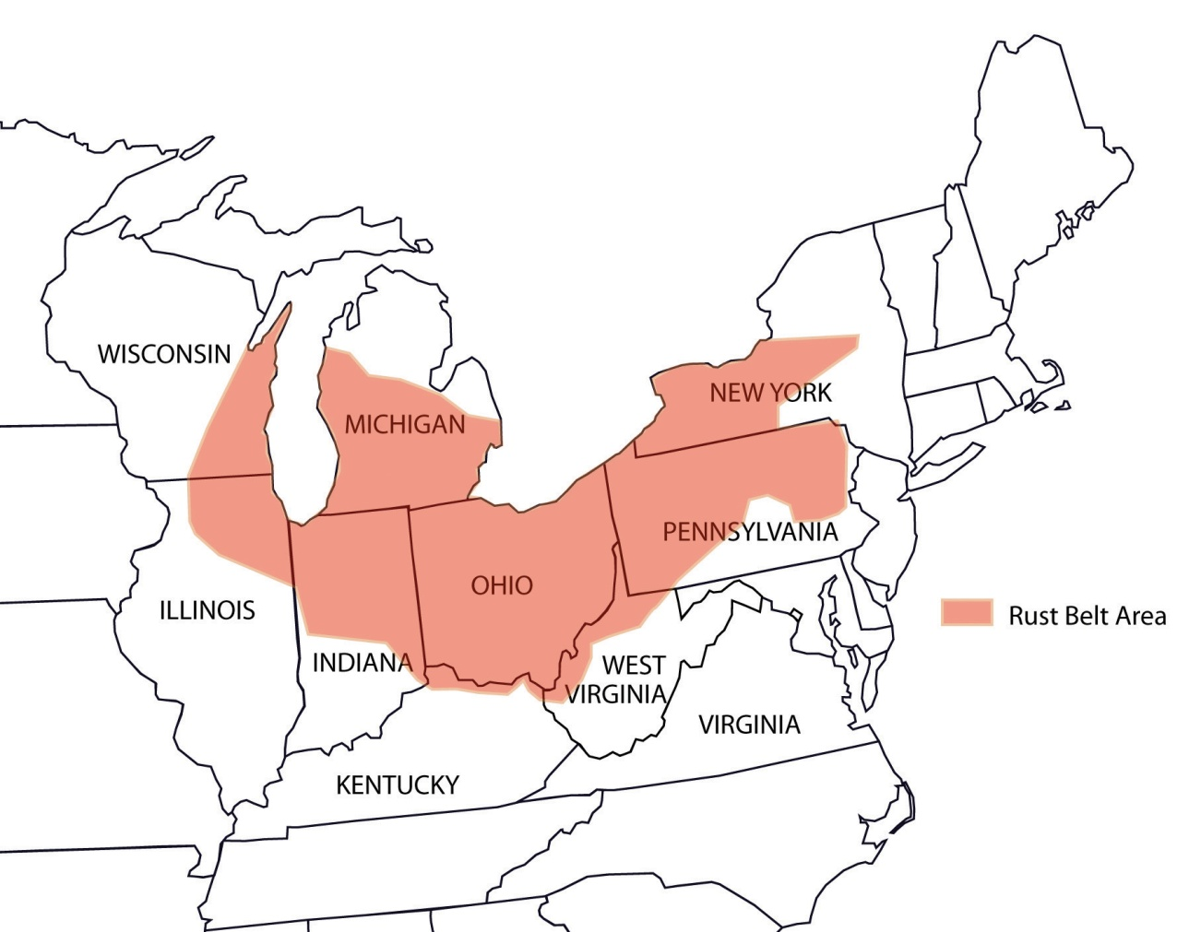
Which of the following groups of American cities is part of the Rust Belt?
Q.28
A. Detroit, Buffalo, and Cleveland
B. San Jose, Palo Alto, and Cupertino
C. St. Louis, Little Rock, and Oklahoma City
D. Atlanta, Augusta, and Knoxville

Slide 32
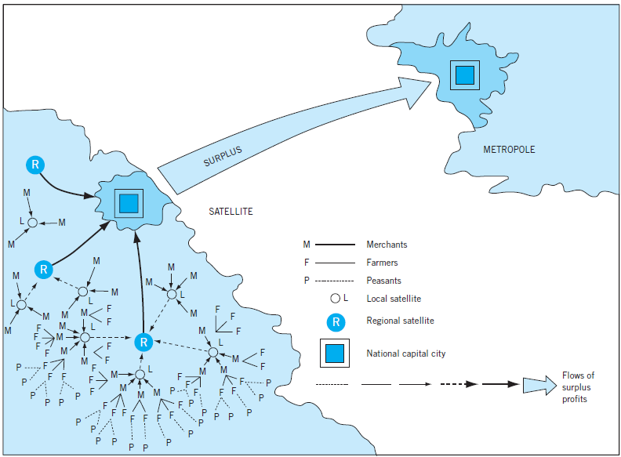
This schematic illustration is representation of:
Q.29
A. Modernization theory B. Central-place theory
C. Dependence theory D. Grass-roots approach

Slide 33
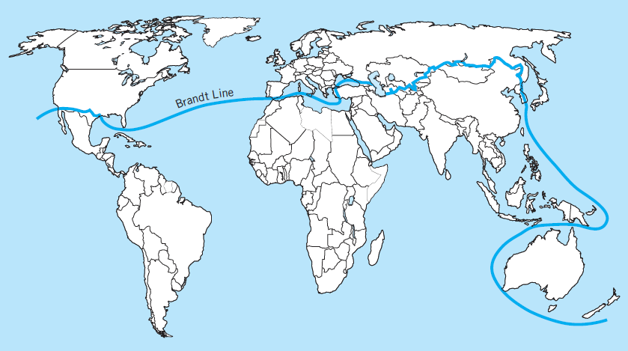
Brandt line is dividing countries of the world in two groups:
Q.30
A. Members and non-members of WTO
B. Countries of global North and global South
C. Countries with high and low life expectancy
D. Members and non-members of OECD

Slide 34
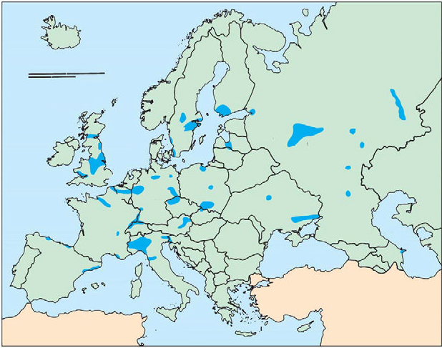
What does this map represent?
Q.31
A. Industrial regions of Europe
B. Coal mining areas of Europe
C. Lead mining areas of Europe
D. Bauxite mining areas of Europe

Slide 35
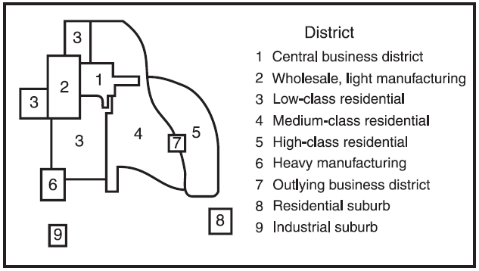
Which classical model of urban structure does this figure represent?
Q.32
A. Concentric zone model B. Sector model
C. Multiple nuclei model D. Garden city

Slide 36
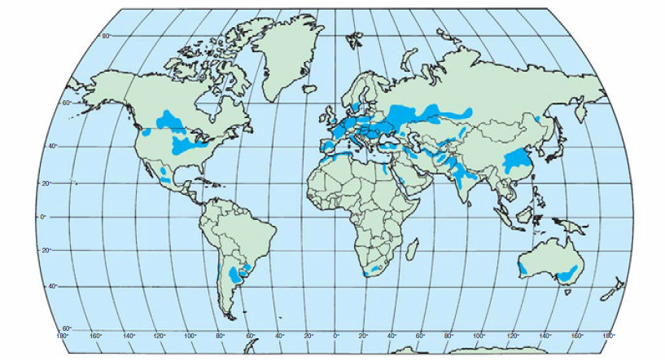
This map shows the distribution of:
Q.33
A. Principal wheat-growing areas B. Principal corn-growing areas
C. Principal rice-growing areas D.Principal apple-growing areas

Slide 37
The top ten producers of this product are shown in the table. What is the product?
Q.34
Country | Production in kilograms
China | 320,000
USA | 223,000
Australia | 222,000
South Africa | 197,698
Russian federation | 190,693
Peru | 182,391
Indonesia | 130,000
Canada | 97,367
Uzbekistan | 90,000
Ghana | 86,000
A. Alumina
B. Raw steel
C. Gold
D. Silver

Slide 38
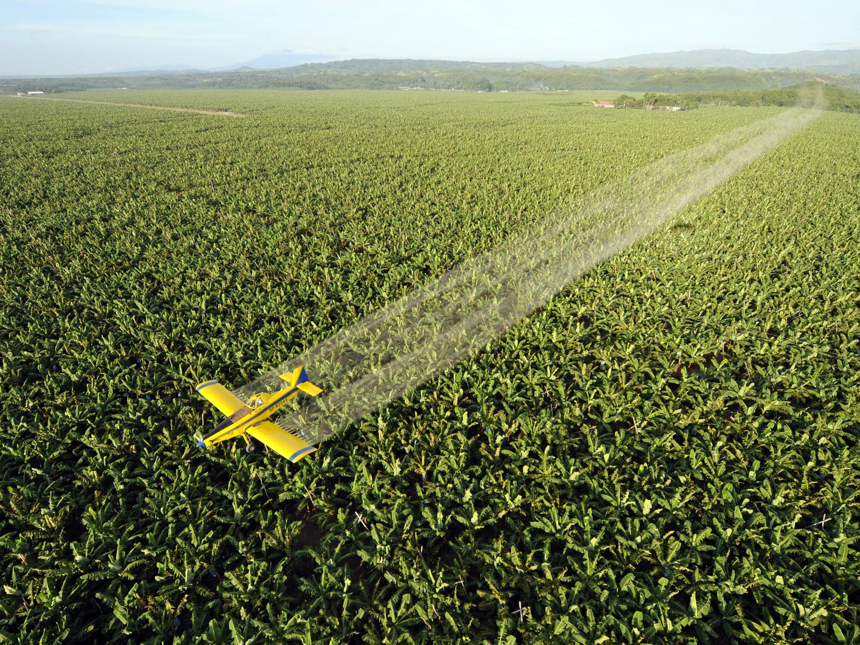
Which form of commercial agriculture is found primarily in developing countries?
Q.35
A. Plantation agriculture B. Livestock farming
C. Mixed farming D. Dairy farming

Slide 39
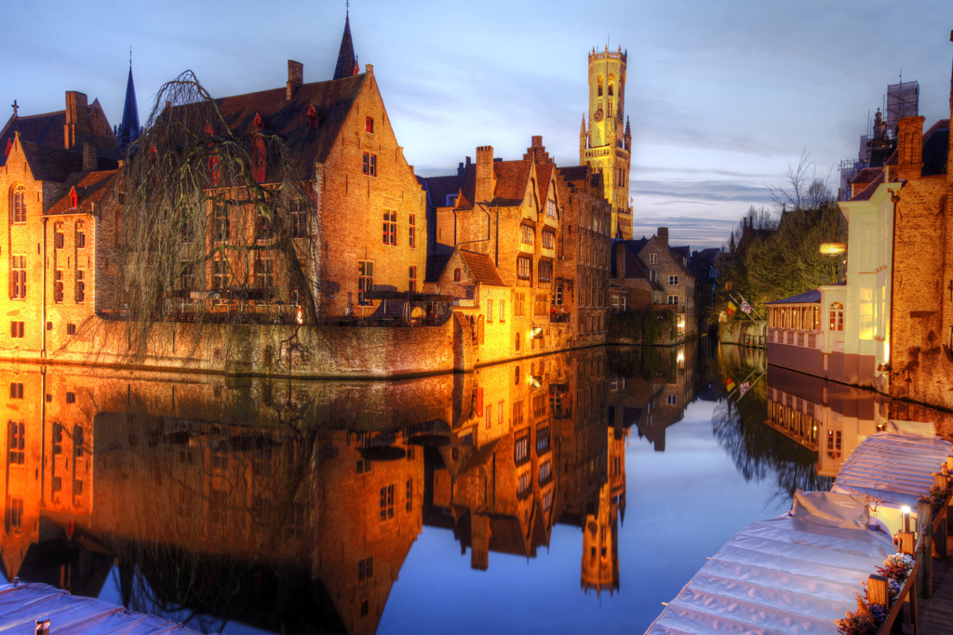
Where was the picture taken?
Q.36
A. Utrecht
B. Amsterdam
C. Antwerp
D. Bruges

Slide 40
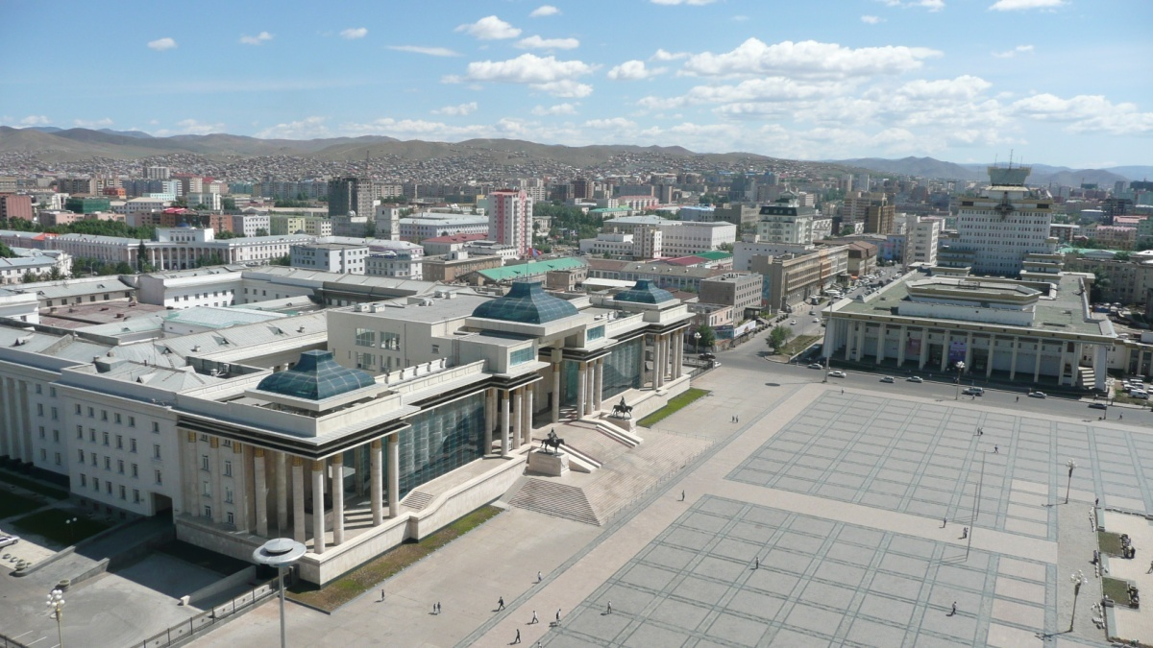
This photograph was taken in a capital city located near 116 degrees East. The country to which this capital belongs to is well known for its low population density. Which two cities are located at the same longitude as the city in the photograph?
A. Ho chi minh city and Jakarta
B. Phnom Penh and Kuala Lumpur
C. Vientiane and Singapore
D. Manila and Canberra
Q.37

Slide 41
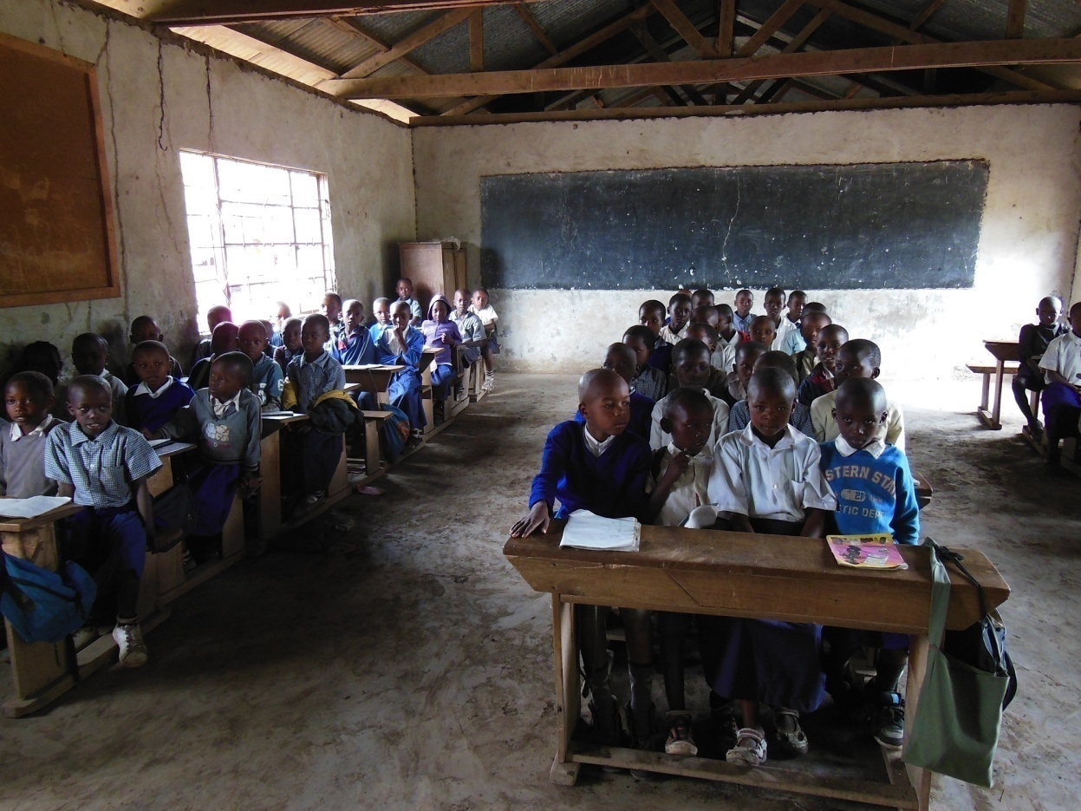
Which of the following is true regarding least developed countries (LDC) and most developed countries (MDC)?
Q.38
A. LDC have lower infant mortality rates than MDC.
B. LDC have higher standards of living than MDC.
C. MDC have lower illiteracy rates than LDC.
D. Economies of MDC have more reliance on agricultural production than LDC.

Slide 42
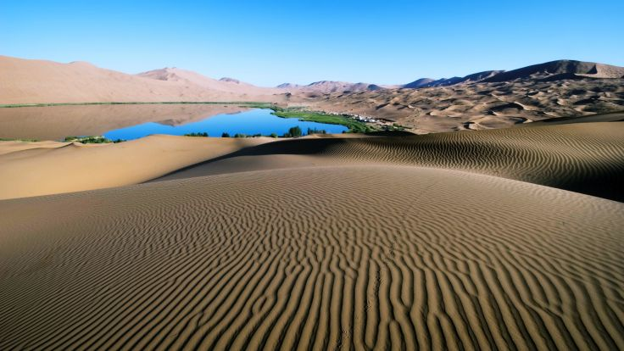
Which regions have the fewest freshwater resources per capita?
Q.39
A. Latin America and the Caribbean
B. Europe and Central Asia
C. Middle East and North Africa
D. Sub-Saharan Africa and South Asia

Slide 43
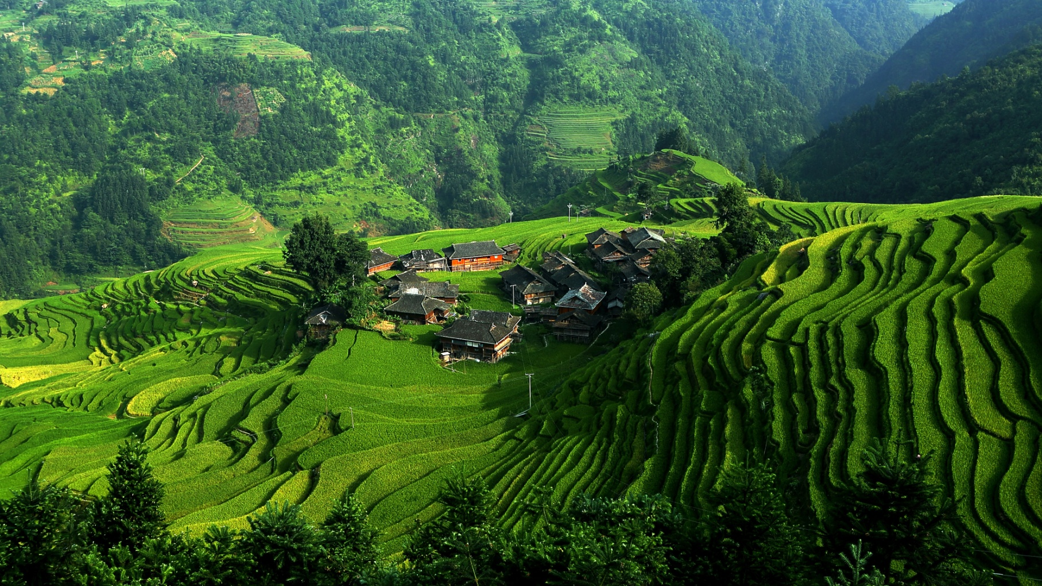
Which of the following countries has the least arable land per capita?
Q.40
A. Canada B. Australia
C. Kazakhstan D. China

